Slide 1
Computational Photography
Independent Study Presentation 2:
Generalized Optics for Computational Photography
Presented By:
Apoorva Srivastava
MS by Research,
IIIT Hyderabad
Guide and Advisor:
Dr. Anoop Namboodiri

Slide 2
Introduction
Animal Eyes
Light Field
Generalised Optics
Understanding Light field
Optical Coding Approaches
Object Side Coding
Pupil Plane Coding
Point Spread Function
Coded Aperture
Sensor Side Coding
Conclusion
References
Light Field Parameterization
Optical Element Formulation
Basic Concepts of Object Side Coding
Wavefront Coding
Fourier Slice Theorem
Coding In-front of the Sensor Plane
Generalized Optics Coding Approaches
Summary of Research using Generalized Optics
Object Side Coding Examples with Homogenous Optical Element
Object Side Coding Examples with Non-Homogenous Optical Element
Basic Concepts of Pupil Plane Coding
Basic Concepts of Sensor Side Coding
Digital Camera Formulation
Overview of the Presentation

Slide 3
Introduction

Slide 4
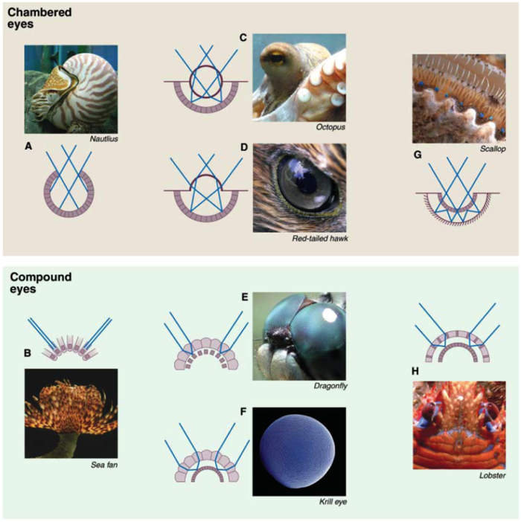
Animal Eyes
Only 8 types of eyes in whole nature!!!
In 33 Animal Phyla-
Only1/3rd have EYES!!!
3 categories of eyes:
1/3rd have no organs to detect eyes
1/3rd have light sensitive organs
Compound eyes
Light detecting spots
Chambered eyes

Slide 5
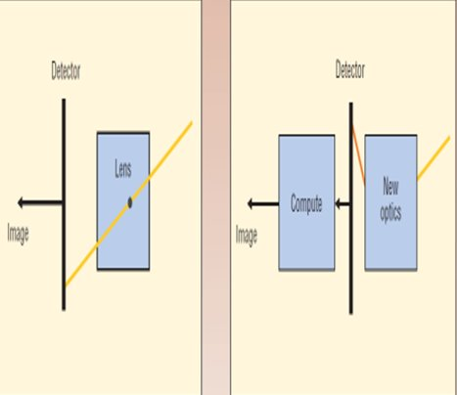
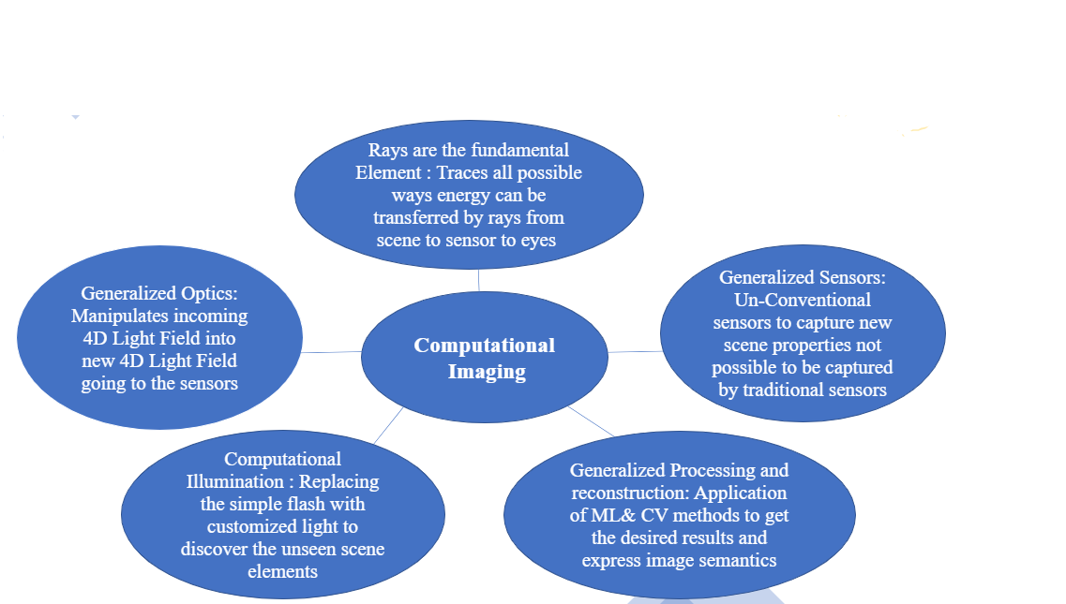
Generalized Optics
Digital Photography
Computational Photography

Slide 6
Light Field

Slide 7
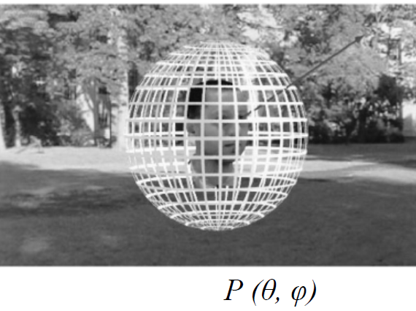
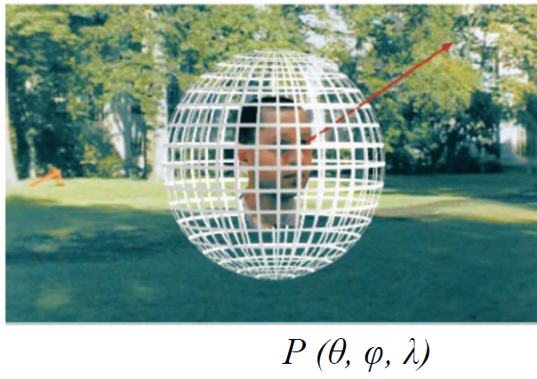
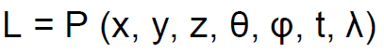
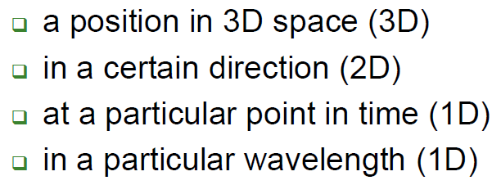
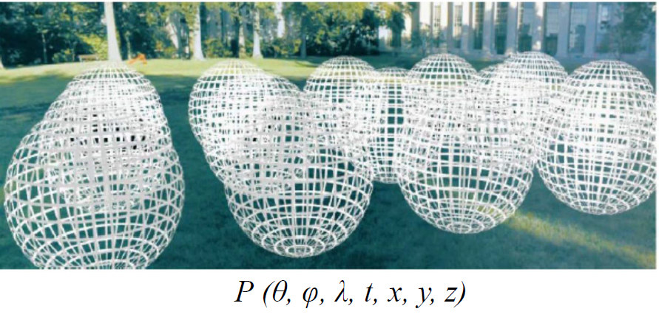
Understanding Light Field
Complete Light Field is represented by:
Space with obstacles Light Field : 5D
Space without obstacle Light Field: 4D

Slide 8
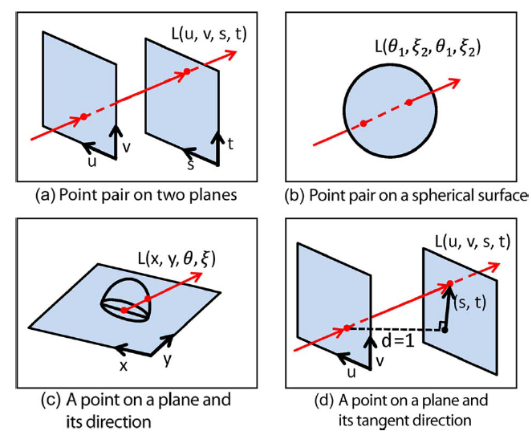
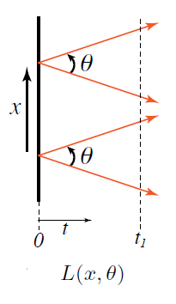
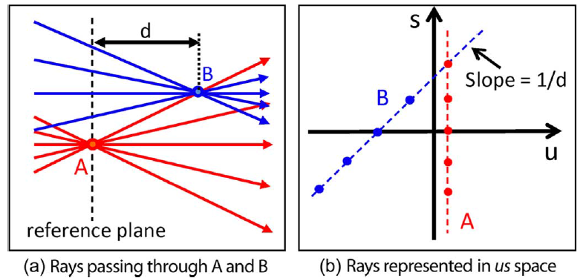
Light Field Parameterization
4 ways of Light Field Parameterization
Simplification in
2D
Ray Representation in u-s space

Slide 9
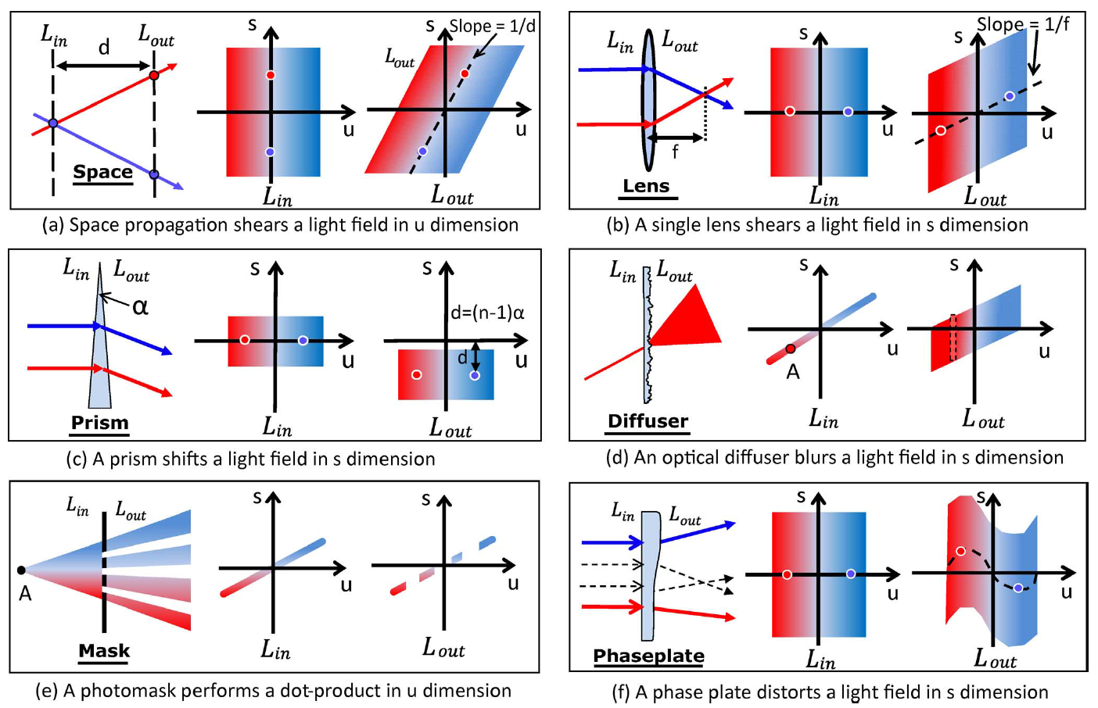
Optical Element Formulation

Slide 10
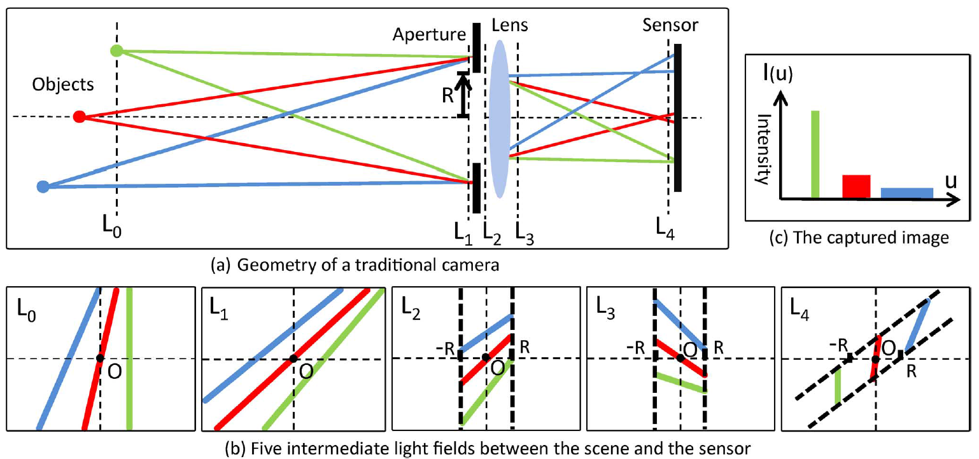
Digital Camera Formulation

Slide 11
Optical Coding Approaches

Slide 12
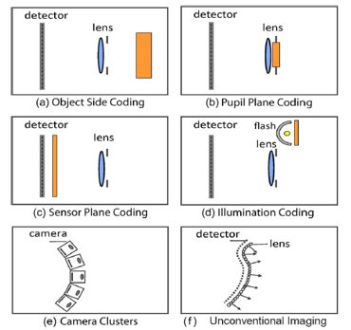
Optical Coding Approaches
Object side coding: An optical element is attached externally to the conventional Lens.
Pupil plane coding: An optical element is placed at, or close to, the aperture of the lens.
Sensor side coding: An optical element is placed behind the lens.
Illumination Coding: Imaging systems that program the illumination.
Camera Clusters: Imaging systems that are made up of a cluster or array of traditional camera modules.
Unconventional Imaging: Imaging systems using unconventional camera architectures or nonoptical devices.

Slide 13
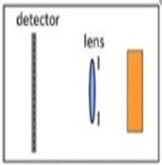
Object Side Coding

Slide 14
Basic Concepts of Object Side Coding
When Optical Element is Non-Homogenous
When Optical Element is Homogenous
The cones of light from the same point of object to the optical element will fall on different points on the optical element which are sheared to different locations on the lens.Hence, the modifications become spatially variant with viewing angle in a single shot.
The Modifications to the Incident Lightfield can be done temporally even though it provides spatially uniform manipulations to all the Lighfields
Detector Lens Optical Element

Slide 15
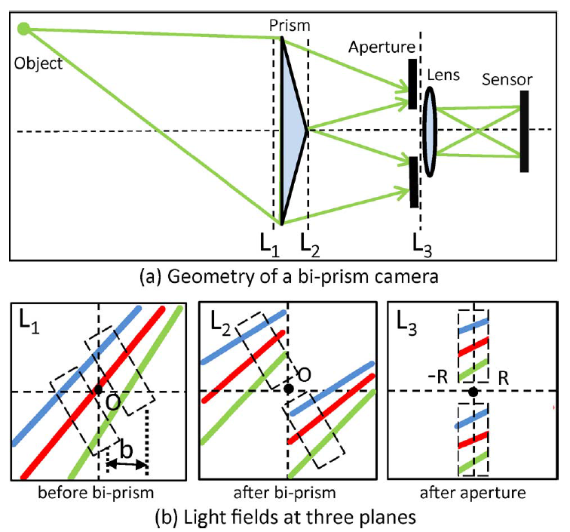
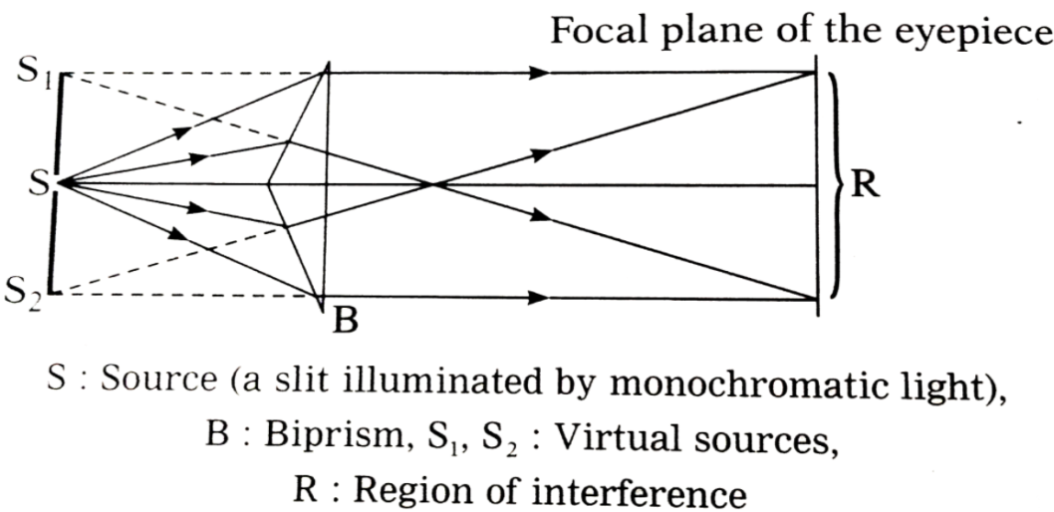
Object Side Coding Examples
with Non-Homogenous Optical Element
Depth Estimation
Bi –Prism
Baseline = 2*tan(α)*d
α--> Prism Angle
D--> distance b/w by-prism and lens

Slide 16
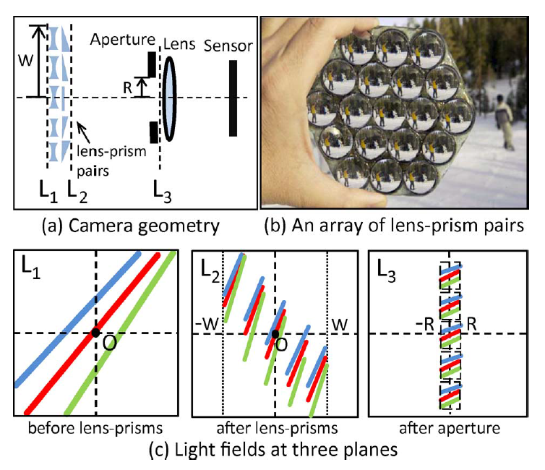
Object Side Coding Examples
with Non-Homogenous Optical Element
4D-Light Field Acquisition
An array of by-prism is kept in-front of the Lens, with each prism having different deviation angle
A Concave Lens is kept in-front of prism array to enhance FOV
However, spatial resolution is compromised for the angular resolution
Multiple copies of the scene are obtained as if viewed from diferent angle.
Hence, Light field can be aquired from a single image

Slide 17
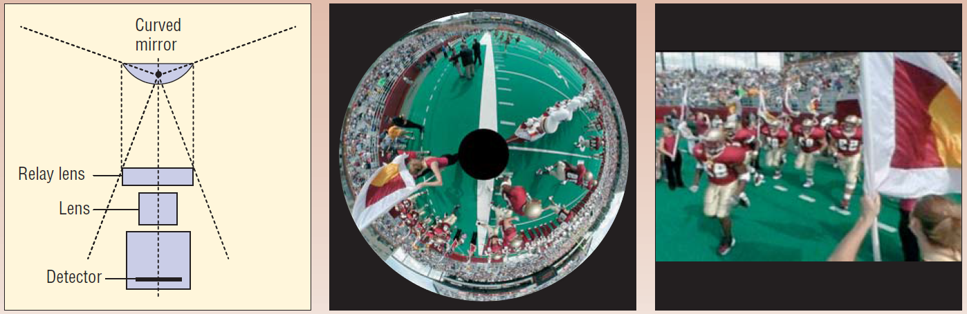
Object Side Coding Examples
with Non-Homogenous Optical Element
Extending FOV
It’s a Catadioptric camera made by combining a lens and a mirror
It is designed to ensure that camera captures all the principle rays of the scene pass through the center of projection
Method doesn't require static scene and only single camera & single shot is required
FOV in horizontal plane: 360 degree. FOV in vertical plane: 220 degree
The compressed image can be easily decoded to perspective image by a dedicated computational module at video rate

Slide 18
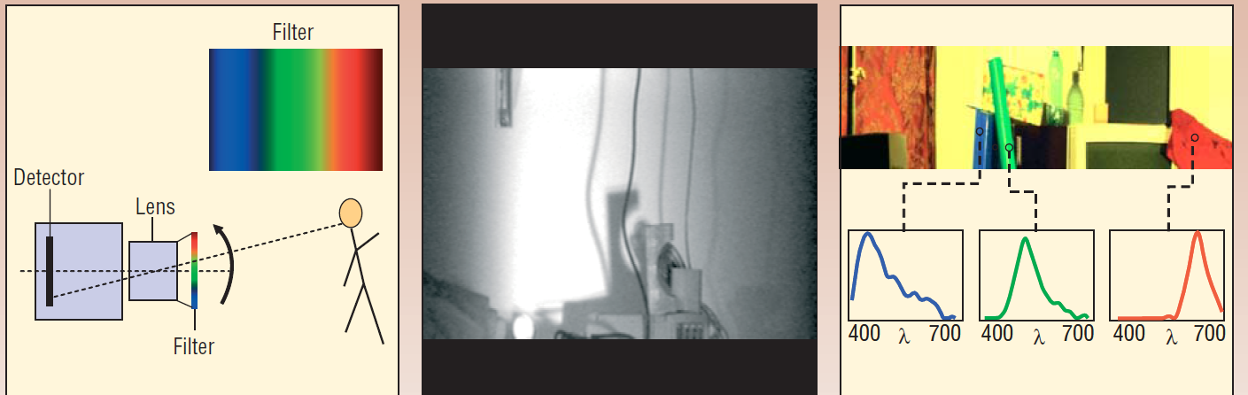
Object Side Coding Examples
with Non-Homogenous Optical Element
Multi-Spectral Imaging
Bi –Prism
Attaching a Linear Interference Filter having spatially varying property of passing different wavelength of visible spectrum,when attached to a black and white video camera it can capture multiple wavelength information of the scene which can be displayed together after interpolation using software.

Slide 19
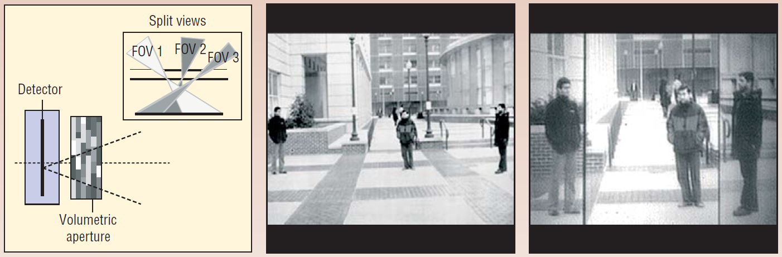
Object Side Coding Examples
with Non-Homogenous Optical Element
Split FOV (Lens-Less Imaging)
It is designed by placing 3D(Volumetric Aperture) in front of the detector instead of Lens
Proper arrangement of regions of full transmittance and zero transmittance across the volume can lead disconnected FOV to be mapped on adjacent sensor area
Further research scope lies in making the transmittance programmable and controllable.
The aperture is implemented as a stack of controllable 2D apertures. Each aperture is a liquid crystal (LC) sheet.
One application is to image the desired FOV in higher resolution than wasting pixels on non-interest scene areas

Slide 20
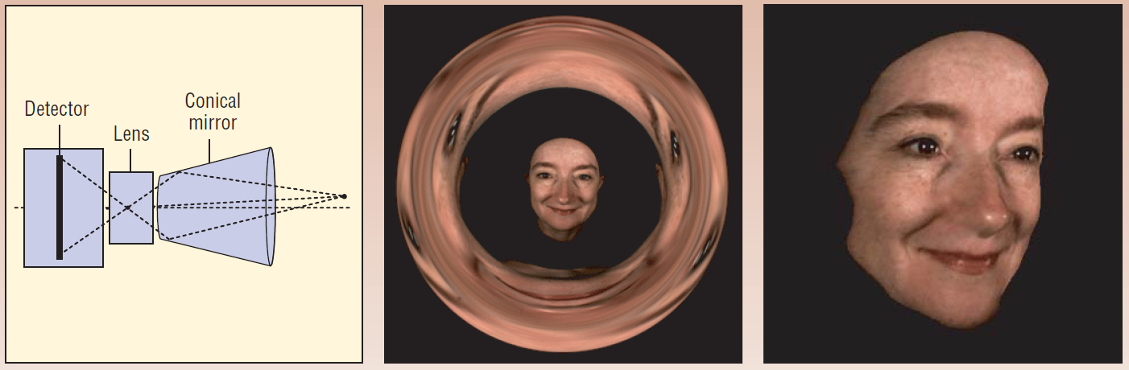
Object Side Coding Examples
with Homogenous Optical Element
Multi-View Radial Camera for 3D Imaging
A hollow cone, mirrored inside, is placed in-front of the traditional camera with the axes aligned.
Each scene point is imaged 3 times, once directy and 2 times after getting reflected from 2 point on the conical mirror.
Hence, 3 viewpoints are obtained. One is at the center of the sensor and the other 2 virtual viewpoints are equal and opposite wrt Optical axis on the sensor
A Stereo Matching algo can find coreespondence between the 3 views and can give the depth information.

Slide 21
Object Side Coding Examples
with Homogenous Optical Element
Other Applications
Capturing image with different polarization direction in order to remove specular reflection
Coding external shutter for coded exposure to remove motion blurring
Placing Optical Diffuser on the object side for depth estimation as it gives larger angle triangulation etc.

Slide 22
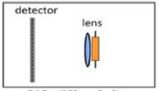
Pupil Plane Coding

Slide 23
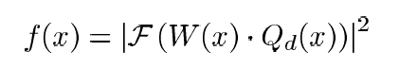
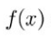
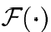
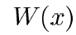
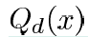
Basic Concepts of Pupil Plane Coding
Unlike Object Side Coding,Light reaching the Pupil Plane of the Lens is spatially invariant
Coding Done on the Pupil Plane has the aim of modifying the Point Spread Function of the Lens
The Fresnel equation describes the relation between the Pupil Plane Coding and Resulting PSF:
PSF function
Fourier Transform
Aperture coding function
Quadratic Phase Term
Lens +Optical Element
Detector

Slide 24
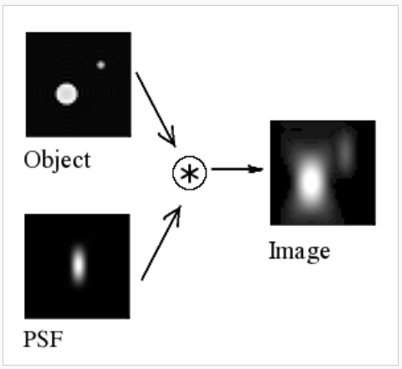
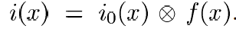
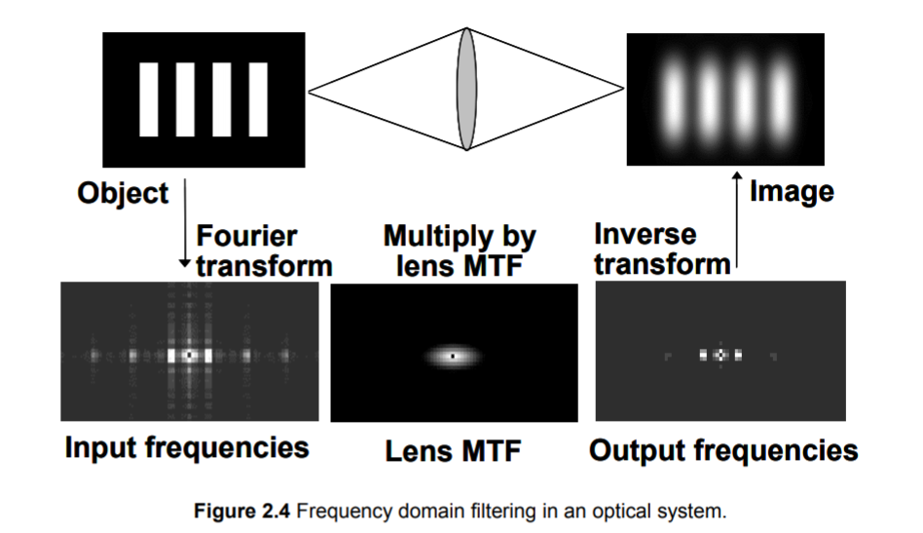
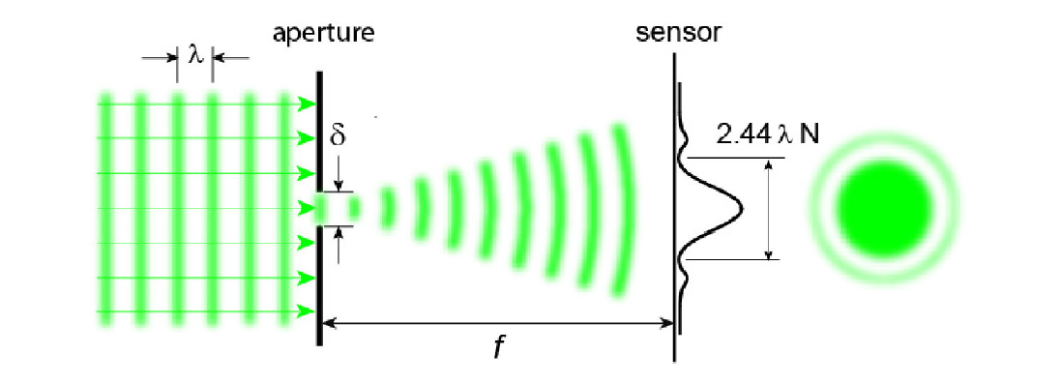
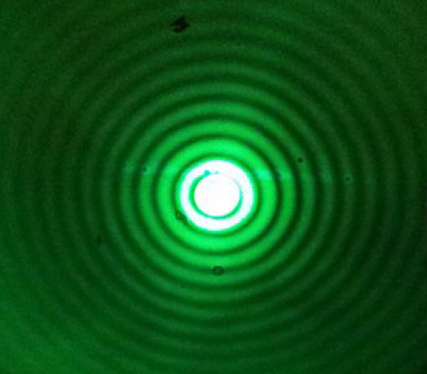
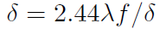
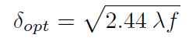
Point Spread Function
Point Spread Function:
It is a function that describes the response of a focussed imaging system to a point source at a given distance.
Finding Optimum Aperture Size at a given distance:
Small Aperture and the diffraction leading to Airy Disk and Diffraction Rings

Slide 25
Basic Concepts of Pupil Plane Coding
Pupil Plane Coding
Coded Aperture
Involves Pupil Plane Coding with Intensity Modulators
Wavefront Coding
Involves Pupil Plane Coding with Phase Modulators
Aperture Coding Function is Real
Aperture Coding Function is Complex

Slide 26
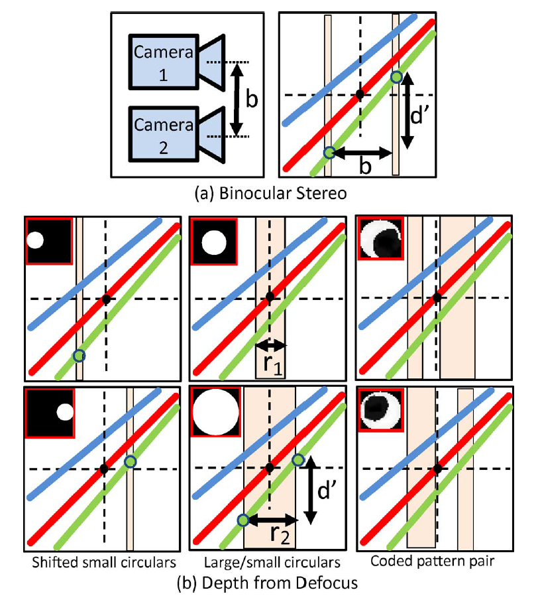
Coded Aperture
Depth from Defocus
Here we compare Binocular Stereo with the Coded Aperture Technique for calculating the Scene Depth
In terms of Light Field Representation,Slope of a stripe is inverse of the depth. So both the techniques go for Slope Calculation
Binocular Stereo establishes the correspondences and calculate (focal length normalized disparity)/(baseline)
DFD using Coded Aperture calculate different integral across each stripe to calculate blur kernel size by DFD algo
Slope for DFD is (focal length normalized blur kernel radius)/(aperture diameter)

Slide 27
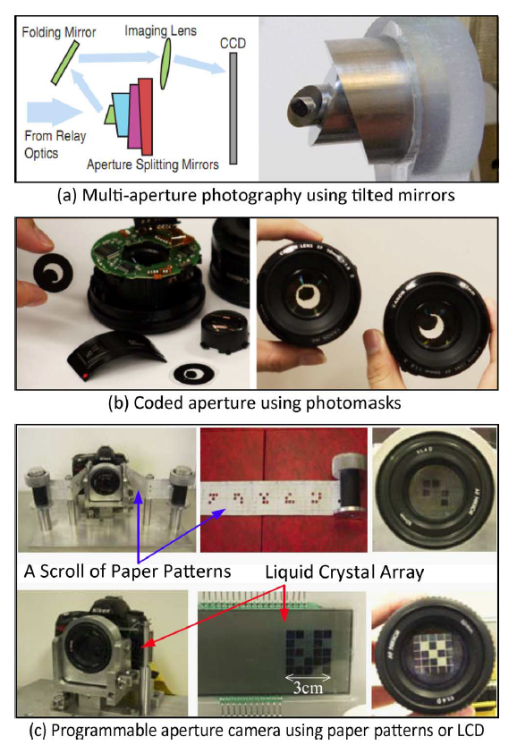
Coded Aperture
Other Applications
Defocus Deblurring
If Point Spread Function is known,then deconvolving the captured image with PSF gives high quality sharp image.
Depth Using Coded Aperture for colors
Color Filter Apertures so that 3 color channels are captured with different apertures
Coded Aperture can help in getting broadband MTF with limited and known zero crossing frequencies
Depth information can be obtained by processing each channel image seprately

Slide 28
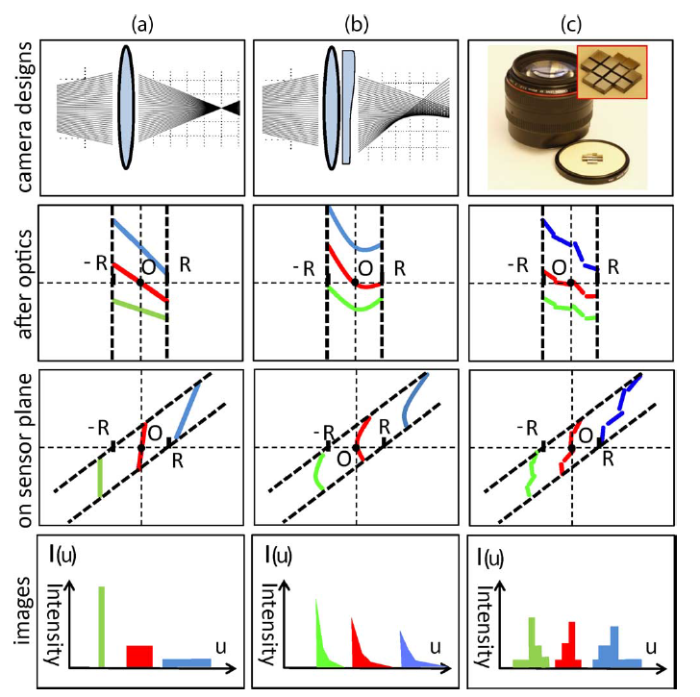
Wavefront Coding
Extending Depth of Field
A cubic phase plate having Aperture Coding function a third order polynomial is used
It results in a broadband MTF without zero-crossing frequencies and is depth invariant as cubic polynomial overpowers the quadratic term varying with depth
The Intensity of a ray falling on the sensor plane depends on its alignment with sensor plane.So the phase plate tilts the light field in a way that images are sharp irrespective of the depth
TraditionalCamera Wavefront coding Lattice-focal Lens

Slide 29
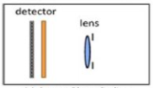
Sensor Side Coding

Slide 30
Basic Concepts of Sensor Side Coding
Optical Element kept on the sensor side of the Lens provides non-convetional optics
According to Gauss Law, Optical Devices after the lens are the dual of the optical devices infront of the lens.Hence, sensor side coding can provide same functionalities as object side coding
Advantage of Sensor Side Coding is that it provide compact solutions which are non-intrusive for scene
Detector Optical Element Lens

Slide 31
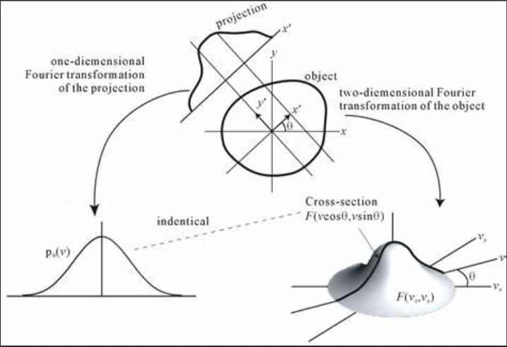
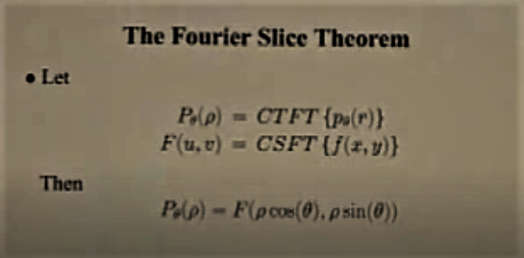
Fourier Slice Theorem
Fourier Slice Theorem Equations
Fourier Slice Theorem Depiction

Slide 32
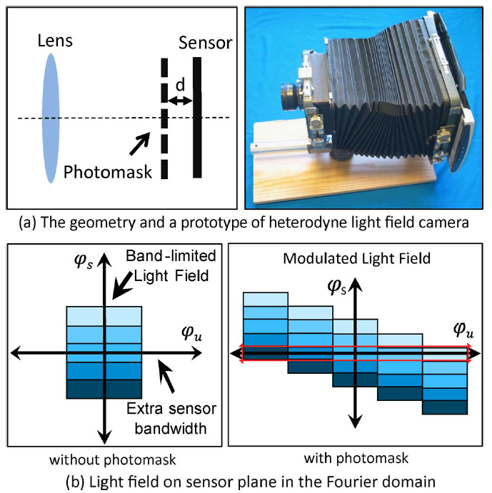
Coding in-front of the Sensor Plane
Light Field Acquisition
M is the shifted cosine signal in spatial domain or shifted Dirac Delta function in Fourier Domain which on getting multiplied with L5 gives multiple copies of L5 each tilted with respect to each other in spatial domain.Each tilted copy projects different projection on the sensor which when combined yields 4D Light Field

Slide 33
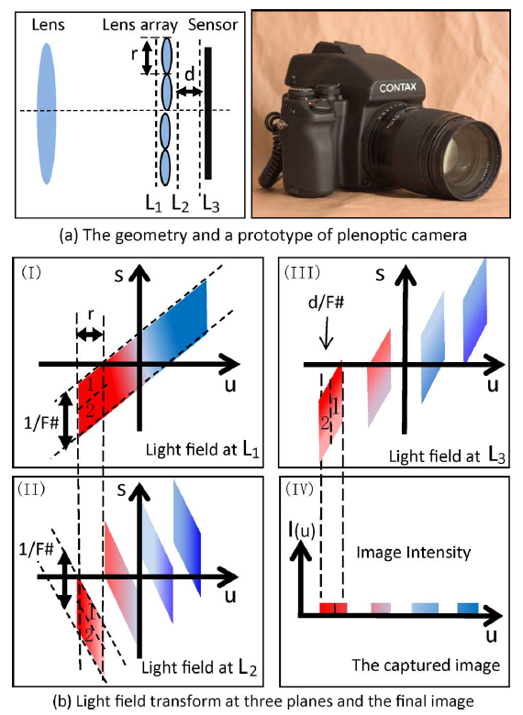
Coding in-front of the Sensor Plane
Light Field Acquisition
The figure demonstrates how the lens array helps in mapping two field components of different angle on same location to be mapped separately which is not possible with traditional camera.

Slide 34
Conclusion

Slide 35
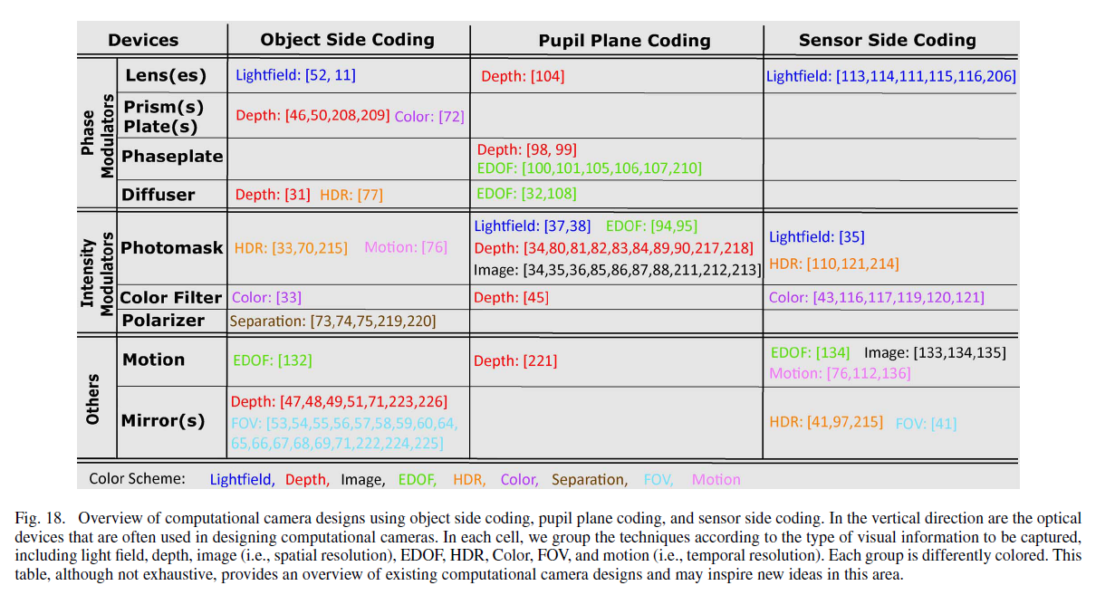
Summary of Research using Generalized Optics

Slide 36
References
Computational Photography by Raskar Tumblin
Computational Cameras: Convergence Of Optics and Processing By Shree K. Nayar and Changyin Zhou
Computational Cameras: Redefining the Image By Shree K. Nayar
https://ocw.mit.edu/courses/media-arts-and-sciences/mas-531-computational-camera-and-photography-fall-2009/
https://www.youtube.com/watch?v=IIrPkh0IH14&t=140s
https://www.youtube.com/watch?v=Koq19e4xVgg&list=PLjRBT0-8H-NHkA7JxZ4b4o5WDgFcbghOd&index=5
https://www.youtube.com/watch?v=Tkc_GOCjx7E
www.computationalphotography.org

Slide 37
Thank You!!!

